Slide 1
UN SYSTEM TASK TEAM ON THE POST-2015 UN DEVELOPMENT AGENDA
Statistics and indicators for the post-2015 development agenda
UNHQ, New York, 26 November 2013
Stefan Schweinfest
(Acting Director, UN Statistics Division, Department of Economic and Social Affairs)

Slide 2
Monitoring and indicators for the post-2015
Development agenda
Two objectives:
Read UNTT report on ‘Statistics and indicators for the post-2015 development agenda’
Come to 17 December 2013 OWG side event on measuring progress

Slide 3
Why MDGs have been good for Statistics…
Creation of the Inter-Agency and Expert Group on MDG Indicators (IAEG)
Unprecedented collaborative effort to prepare Annual MDG Report of the Secretary General
Demonstrable increase of data availability at country level
Increased focus on capacity building to strengthen national statistical systems
Better coordination of international support
----------------------------------------------------------------
BUT: still about 1/3 of the countries have difficulties to report ½ of the MDG indicator series.

Slide 4
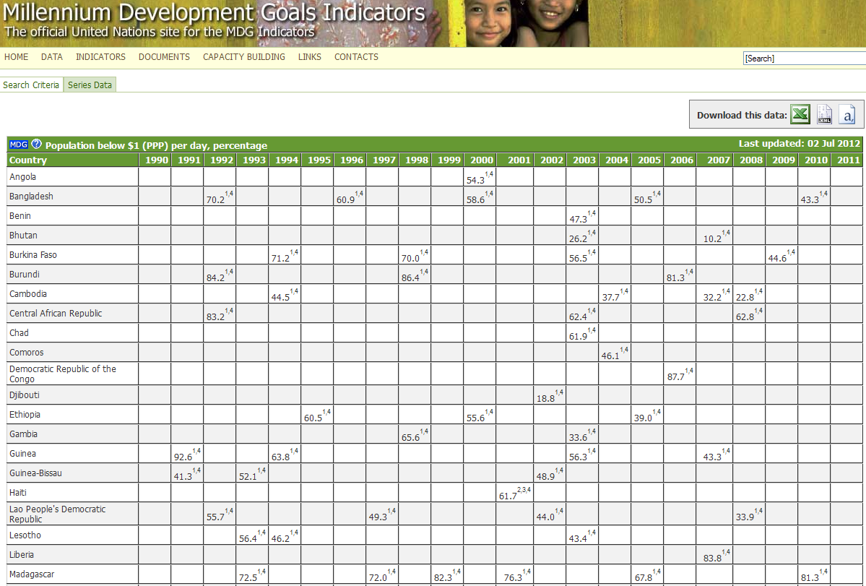
Data points for $1.25 poverty in the ldcs, 1990-2010
UNSTATS/IAEG Database

Slide 5
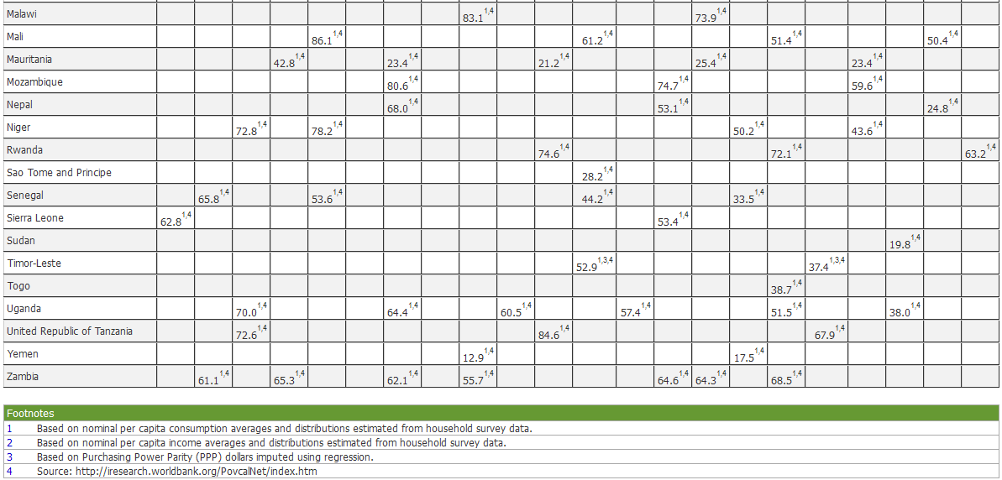
Data points for $1.25 poverty in the ldcs, 1990-2010
UNSTATS/IAEG Database (continued)

Slide 6
Types of targets in the MDG framework
One hundred per cent
1.B. Full and productive employment and decent work for all
Equality
3.A. Eliminate gender disparity in all levels of education
Percentage or ratio change specified
4.A. Reduce by two thirds the under-five mortality rate
Change in rate of change
5.B. Significant reduction in the rate of biodiversity loss
Directional (of percentage or proportion)
6.A. Reverse the spread of HIV/AIDS

Slide 7
Criteria for indicators:
Outcome indicators
Clear link to the target
Well defined statistically
Can be aggregated and disaggregated
Measurable over time
Cost-effective
Clear and easy to communicate
Limited in overall number

Slide 8
Getting the indicators right
Getting the statistics right
Getting the trends right

Slide 9
Indicators for new and cross-cutting themes:
Inequality measures
Population dynamics
Sustainability measures
New monetary and trade aggregates
Governance indicators
Rule of law indicators
Peacebuilding and conflict indicators
Composite indicators
Indicators of satisfaction, perception and attitudes
Technology-based innovations in data collection and indicators

Slide 10
Professional statistical community and the
Central role of the UN Statistical Commission
UN Statistical Commission:
Designated inter-governmental body responsible for development indicators
Your = member states’ expert representatives
Strong global participation
Covers all statistical fields
Develops global statistical standards and methods
Ensures quality control
Oversees coordination among UN statistical programmes

Slide 11
Friends of the Chair on Broader Measures:
UN Statistical Commission decision March/2013:
“….. to ensure that a robust statistical measurement approach is incorporated from the outset in preparations for the post-2015 development agenda”
Develop broader measures of progress (Rio+20, para. 38)
Engage in dialogue with OWG: 17. December side-event
Prepare statistical notes on the topics of the OWG agenda

Slide 12
OWG side event on measuring progress:
(17 December 2013)
“A dialogue between national statisticians
and development specialists”:
Lessons learned from the monitoring of the MDGs and Sustainable Development Indicators (SDIs)
Review of existing proposals and their statistical requirements
Roadmap for measurement

Slide 13
Data revolution = Investing in national statistical systems:
Strengthen infrastructure
Censuses and surveys
Explore new data sources
Open access
Working with users
Sustainable development requires sustainable statistics

Slide 14
Thank you
Stefan Schweinfest
Acting Director
UN Statistics Division/DESA
schweinfest@un.org
http://unstats.un.org/

